Slide 1

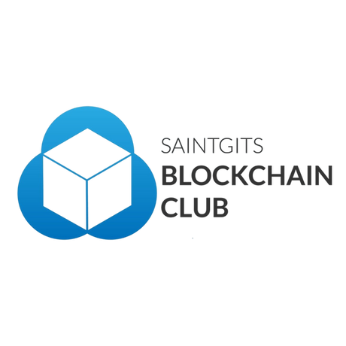



Kickstart: Blockchain Made Easy
Beginner Workshop
Presenters: Varsha Ann Biju & Vasudev V
Organized by: SAINTGITS BLOCKCHAIN CLUB
@blockchain.saintgits
@SAINTGITS BLOCKCHAIN CLUB
Notes:
`

Slide 2

What is Blockchain?
Blockchain is a revolutionary digital ledger system that records transactions in a secure, transparent, and permanent way. Unlike traditional databases controlled by a single entity, blockchain operates on a network of computers, making it decentralized and resistant to tampering.
Think of blockchain like a Google Doc that everyone can view simultaneously. When someone makes a change, everyone sees it in real time. But unlike a Google Doc, once information is added to the blockchain, it becomes immutable – it cannot be altered or deleted. This creates an unprecedented level of trust and transparency.
Key features that make blockchain special include decentralization (no single point of control), immutability (permanent records), and shared consensus (everyone agrees on the state of the ledger).
Notes:
Blockchain technology emerged in 2008 as the underlying foundation for Bitcoin, introduced by the pseudonymous Satoshi Nakamoto. The initial goal was to create a decentralized, peer-to-peer electronic currency that did not rely on central banks or governments, leveraging cryptography and distributed networks to ensure trust and transparency. Over time, blockchain evolved far beyond cryptocurrencies, enabling decentralized applications, smart contracts, and enterprise solutions.
Key Milestones:
1991: Stuart Haber and W. Scott Stornetta published work on a cryptographically secured chain of blocks to prevent document tampering.
2008: Bitcoin whitepaper published.
2009: First Bitcoin block (Genesis block) mined.
2013-2015: Ethereum introduced the concept of smart contracts, moving the technology from a simple currency ledger to a general-purpose programmable platform.
2020s: Accelerated enterprise adoption and the expansion of Decentralized Finance (DeFi) and Web3 concepts.

Slide 3






Why Blockchain Matters
Blockchain technology is transforming how we think about trust, security, and data management in the digital age. It addresses fundamental challenges in our interconnected world by removing the need for intermediaries and creating systems that are inherently more secure and efficient.
Transparency
Security
Every transaction is visible to all participants, creating accountability and reducing fraud
Cryptographic protection and distributed networks make hacking extremely difficult
Trust
No Single Point of Failure
Mathematical verification replaces the need to trust intermediaries or central authorities
Distributed architecture ensures the system continues functioning even if nodes fail
Real-World Applications: Digital payments without banks, self-executing smart contracts that automate agreements, supply chain tracking that verifies product authenticity, secure medical records, voting systems, and digital identity management.
Notes:
Blockchain is a decentralized, immutable digital ledger that records transactions across multiple computers (nodes). It is a distributed digital ledger technology (DLT) that eliminates the need for central authorities, providing security, transparency, and accountability.
Core Characteristics
Decentralization: Data is distributed across several computers (nodes) rather than stored in one place, removing single points of failure.
Immutability: Once a transaction is confirmed, it cannot be modified or deleted, guaranteeing permanent and verifiable records.
Consensus Mechanisms: Network participants agree on the validity of transactions through mathematical protocols.
Transparency: Every transaction is visible to all participants, creating accountability and trust.
Security: Advanced cryptography ensures that once information is added, it is mathematically secured from tampering.
Roles and Importance
Establishes Trust: Provides trust in digital transactions without intermediaries.
Ensures Transparency: The ledger is distributed and visible to all participants.
Enhances Security: Transactions are encrypted and distributed, making it nearly impossible for hackers to alter data.
Facilitates Automation: Enables automation via smart contracts.
Analogy: Blockchain can be compared to a digital notebook (the ledger) shared among many participants (nodes) where every transaction is recorded permanently , visible to all, and protected against tampering.

Slide 4




How Blockchain Works
A Simplified Journey Through the Chain
Transaction Created
Block Formation
A user initiates a transaction, which contains data about the transfer or action
The transaction is bundled with others into a block containing data, a unique hash, and the previous block's hash
Consensus Reached
Chain Extended
Network nodes validate the block through mechanisms like Proof of Work or Proof of Stake
The verified block is linked to the chain, creating a permanent, tamper-proof record
The brilliance of blockchain lies in its tamper resistance. Each block contains a unique fingerprint (hash) of its contents plus the hash of the previous block. If someone tries to alter data in one block, its hash changes, breaking the chain and alerting the entire network. This makes fraudulent changes virtually impossible.
Notes:
Blockchain consists of individual data containers called blocks connected sequentially in a chain. The entire structure relies on a logical process of data creation, verification, and permanent recording.
Structure of a Block:
Transaction data (a bundle of verified transactions)
Timestamp
Previous block hash (the cryptographic link to the prior block)
Current block hash (the unique identifier for this block)

Slide 5






Types of Blockchain
Not all blockchains are created equal. Different use cases require different levels of access, control, and transparency. Understanding these variations helps you choose the right blockchain architecture for your specific needs.
Public Blockchain
Private Blockchain
Open to Everyone
Restricted Access
Anyone can join, read, and write transactions. Fully decentralized and transparent.
Controlled by a single organization with permission-based participation.
Examples: Bitcoin, Ethereum
Examples: Hyperledger Fabric
Best for: Cryptocurrency, DeFi, NFTs
Best for: Enterprise systems, internal audits
Trade-off: Slower, requires more energy
Trade-off: Less transparent, more centralized
Consortium Blockchain
Hybrid Blockchain
Group-Controlled
Best of Both Worlds
Managed by a pre-selected group of organizations rather than a single entity.
Combines public and private features, controlling what data is public vs. restricted.
Examples: R3 Corda, Energy Web Chain
Examples: Dragonchain, XinFin
Best for: Banking consortiums, industry collaborations
Best for: Healthcare, real estate, regulated industries
Trade-off: Partially decentralized
Trade-off: More complex to implement
Notes:
Depending on who can access and validate data, there are four major types of blockchain networks.
Public Blockchain: Open to everyone to join and participate. It is fully decentralized and transparent but typically slower due to the large number of participants. (Examples: Bitcoin, Ethereum ).
Private Blockchain: Controlled by a single organization with restricted access. It is efficient and fast but less transparent. (Example: Hyperledger Fabric ).
Consortium Blockchain: Operated by a group of organizations sharing control. It combines shared governance and semi-transparency. (Example: R3 Corda ).
Hybrid Blockchain: Mixes features of public and private networks, allowing partial transparency. Used in regulated sectors like healthcare or government.

Slide 6


Consensus Mechanisms
These are protocols through which all network participants agree on the validity of new transactions.
1
Proof of Work (PoW)
Miners solve complex mathematical puzzles to validate blocks. This mechanism is highly secure but energy-intensive.
2
Proof of Stake (PoS)
Validators are selected based on the amount of their own cryptocurrency they have "staked" (locked up) in the network. It is generally more energy-efficient.
3
Practical Byzantine Fault Tolerance (PBFT)
A mechanism that ensures consensus in partially trusted networks, often used in permissioned (private/consortium) blockchains.

Slide 7

Advanced DLT Structures: BlockDAGs
A BlockDAG (Block Directed Acyclic Graph) is a non-linear data structure that significantly improves scalability by allowing multiple blocks to coexist and be processed simultaneously.
Advantage
Unlike linear blockchains, BlockDAGs enable parallel processing of transactions, leading to much higher transaction throughput (faster speed).
Consensus
It uses advanced rules, such as the Heaviest Chain Rule, to achieve consensus while accepting concurrent blocks.

Slide 8




Core Blockchain Concepts
Essential Building Blocks You Need to Know
Wallets
Transactions
Digital containers that store your private keys and manage your blockchain identity. Think of them as your personal vault for cryptocurrency and digital assets. MetaMask is a popular browser-based wallet that we'll use in today's workshop. Your wallet address is like your account number – public and shareable – while your private key is like your password – secret and never shared.
Digital records of value transfer or data exchange on the blockchain. Every transaction is cryptographically signed, validated by network nodes, and permanently recorded. Transactions include sender address, receiver address, amount or data, timestamp, and a small fee to incentivize validators. Once confirmed, transactions become part of the immutable ledger.
Smart Contracts
Gas Fees
Self-executing programs that automatically enforce agreements when conditions are met. Written in code (often Solidity for Ethereum), they eliminate the need for intermediaries. Example: An insurance smart contract could automatically pay out claims when flight delay data meets specific criteria. No human intervention needed – the contract executes itself based on predefined rules.
Small transaction costs paid to miners or validators for processing your transactions and executing smart contracts. Like postage stamps for the blockchain, gas fees prevent spam and compensate those maintaining the network. Fees vary based on network congestion – higher demand means higher fees. In our workshop, we'll use a local blockchain where gas fees are simulated but not real money.
Notes:
Wallets and Keys
Wallets are digital applications that store and manage your private and public keys, enabling secure access to your blockchain identity.
Public Key: Acts like your account number, shareable for receiving transactions.
Private Key: Functions as your password; it must never be revealed.
Example: MetaMask is a common example of a web-based wallet.
Smart Contracts
Smart contracts are self-executing programs stored on the blockchain with the terms of an agreement directly written into code. They automatically perform actions when predetermined conditions are satisfied.
Benefits: Reduces intermediaries, automates processes, and prevents fraud and errors.
Development: The Ethereum blockchain primarily uses Solidity for writing these contracts.
Example: A smart contract could automatically pay insurance when flight delay data meets the required conditions.

Slide 9

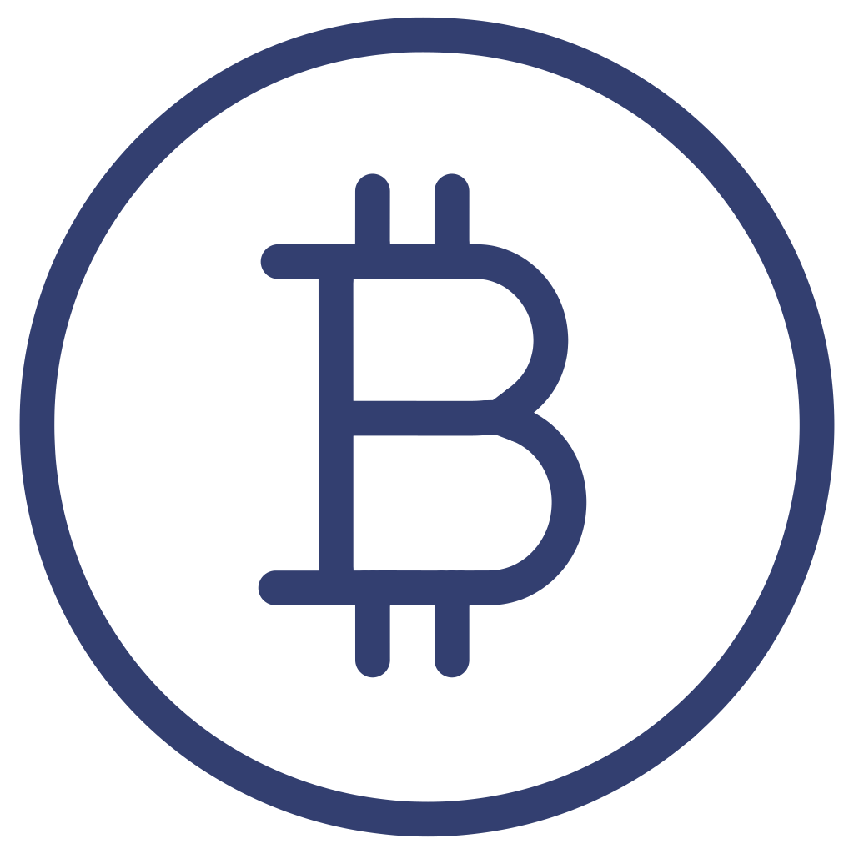
Cryptocurrencies
Cryptocurrencies are digital or virtual currencies using cryptography for security. The blockchain records every transaction immutably.
How They Work:
Users have wallets with public/private keys
Transactions are verified by network nodes
Mining or staking validates the transactions
Examples: Bitcoin, Ethereum, Ripple

Slide 10

Advantages and Challenges
Advantages of Blockchain:
Challenges and Limitations:
Security: Highly resistant to tampering and cyber-attacks
Scalability: High transaction volumes can slow networks, although solutions like BlockDAGs are emerging
Transparency: The ledger is visible to all participants
Efficiency: Reduces intermediaries, speeding up processes
Energy Consumption: PoW networks are resource-heavy (addressed by PoS)
Traceability: Provides a full, auditable trail
Regulation: Legal frameworks are still evolving globally
Cost Reduction: Minimal third-party involvement lowers transaction costs
Interoperability: Difficulty in cross-chain communication
Privacy: Public blockchains expose transaction data (though often pseudonymously)

Slide 11





Real-World Blockchain Examples
Blockchain is already transforming industries beyond cryptocurrency, offering practical solutions that leverage its unique features of transparency, security, and immutability. Here are some everyday applications:
Food Traceability
Digital Art & NFTs
Luxury Goods
Track produce from farm to fork. If there's a recall, blockchain quickly identifies contaminated batches, protecting consumers and reducing waste.
Blockchain assigns unique, verifiable ownership to digital creations like art or music, ensuring authenticity and protecting creators' rights.
Verify the origin and authenticity of high-value items like designer bags or watches, combating counterfeiting and ensuring genuine products.
Medical Records
Voting Systems
Patients can securely control access to their health history. Blockchain ensures records are tamper-proof and shareable only with consent.
Enhance trust in elections by recording votes on an immutable ledger. This makes the process more transparent, secure, and fraud-resistant.
These examples highlight how blockchain's core principles can solve real-world problems by fostering trust and efficiency.

Slide 12




The Future of Blockchain: A Glimpse Ahead
Blockchain is more than just a trend; it's a foundational technology poised to reshape our digital world. Understanding its potential is key to navigating the innovations to come.
Industry Transformation
The Rise of Web3
From finance to supply chains, blockchain will continue to drive efficiency, transparency, and trust across diverse sectors globally.
A decentralized internet is emerging, putting user control and data privacy at the forefront, powered by blockchain's robust infrastructure.
Seamless Integration
Innovation & Opportunity
Expect blockchain technology to become an invisible yet integral part of everyday applications, enhancing security and functionality.
Embracing blockchain fundamentals will be crucial for future careers and for those looking to build the next generation of digital solutions.
The journey into blockchain is just beginning. Stay curious, keep learning, and be ready to contribute to this transformative technology.

Slide 13
Blockchain vs. Traditional Systems
Understanding the fundamental differences between blockchain and traditional systems is crucial for grasping blockchain's disruptive potential. It's a shift from centralized control to a distributed, trustless environment.
Traditional Systems
Blockchain Systems
Centralized Control: Data is managed by a single authority (e.g., banks, governments). Think of a single bank controlling all your transactions.
Decentralized Network: Data is distributed and verified across many computers. Imagine everyone having a copy of the ledger.
Trust in Cryptography: Security and validation are achieved through mathematical proof and network consensus, not a third party.
Trust in Intermediaries: You must trust a third party to validate and secure your data or transactions.
Single Point of Failure: If the central server or institution is compromised, all data is at risk.
Distributed Resilience: No single point to attack; the network remains operational even if some nodes fail.
Slower & Costlier: Transactions often involve fees and delays due to intermediary processing.
Faster & Cheaper: Peer-to-peer transactions can be quicker and often incur lower fees.
This shift fundamentally redefines how we manage information and execute transactions in the digital world.

Slide 14
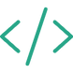

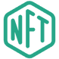
What is Solidity?
Solidity is the primary programming language for writing smart contracts on the Ethereum blockchain. It enables the creation of self-executing agreements that automatically enforce terms, facilitating decentralized applications (dApps). Learning Solidity is key to building secure and transparent blockchain solutions.
Remix IDE
Ganache
MetaMask
Web-based development environment for Solidity.
Personal Ethereum blockchain for local development.
Browser extension wallet to interact with dApps.

Slide 15



Development Tools Overview
To get started with Solidity, a few essential tools will streamline your development, testing, and interaction with the Ethereum blockchain.
Remix IDE
Ganache
A powerful web-based code editor for writing and deploying smart contracts. Think of it as your blockchain coding studio. We'll write Solidity code here and test it instantly in the browser – no installation required.
Your personal Ethereum blockchain running on your computer. It gives you 10 test accounts, each loaded with 100 ETH of fake currency. Perfect for experimenting without spending real money or waiting for slow network confirmations.
MetaMask
A browser extension wallet that connects your web browser to blockchain networks. We'll configure it to connect to your local Ganache blockchain, allowing you to sign transactions and interact with deployed smart contracts just like on the real Ethereum network.

Slide 16

Hello World Contract Code
Let's examine the foundational "Hello World" contract in Solidity. This simple contract demonstrates basic concepts like state variables, constructors, and functions, which are crucial for understanding more complex smart contracts.
// SPDX-License-Identifier: GPL-3.0
pragma solidity ^0.8.20;
contract HelloWorld {
string public message = "Hello, World!";
function getMessage() public view returns (string memory) {
return message;
}
function setMessage(string memory newMessage) public {
message = newMessage;
}
}
string
public
A data type used to store text. Here, it holds our "Hello, World!" message.
A visibility specifier, meaning the variable or function can be accessed from outside the contract and by other contracts.
view
State-changing functions
A function modifier indicating that the function can read the contract's state but cannot modify it. It's a "read-only" function.
Functions like setMessage that modify the contract's state (e.g., changing the value of the message variable). These operations typically cost gas on the Ethereum network.
Notes:
// SPDX-License-Identifier: GPL-3.0
This line specifies the software license — here, GNU General Public License v3.0.
It tells others under what terms they can use or modify your code.
This is required by Solidity compilers for open-source and legal compliance.
It doesn’t affect the program execution — it’s for documentation and licensing purposes.
pragma solidity ^0.8.20;
This tells the Solidity compiler which version of the language to use.
^0.8.20 means the contract can be compiled with version 0.8.20 or higher, but not 0.9.0 or above.
It helps prevent compatibility errors with older or newer versions of Solidity.
contract HelloWorld {
This line defines the start of a smart contract named HelloWorld.
A smart contract is a self-executing program stored on the Ethereum blockchain.
string public message = "Hello, World!";
Declares a state variable named message of type string.
public means anyone can read it (Solidity automatically creates a getter function).
The variable is initialized with "Hello, World!".
This data is stored permanently on the blockchain, meaning every node keeps a copy.
function getMessage() public view returns (string memory) {
Defines a public function that returns a string.
view means it only reads data and doesn’t modify the blockchain.
string memory indicates that the string returned is a temporary (in-memory) copy of the stored data. return message;
Returns the value of the message variable.
When you call this function in Remix (via a blue “call” button), it does not cost gas because it’s a read-only operation.
function setMessage(string memory newMessage) public {
Defines another public function, called setMessage.
It takes one input parameter, newMessage, which is a string stored temporarily in memory.
When called, this function modifies the state variable message.
message = newMessage;
Assigns the new string value to the state variable message.
This changes the blockchain state, so it costs gas to execute.
The transaction must be mined and stored in the blockchain permanently.
In Simple Terms
The contract starts with “Hello, World!” stored on-chain.
Anyone can read the message freely (via getMessage).
Anyone can update it (via setMessage), but updating costs gas, since it writes data permanently.

Slide 17
Sum of Two Numbers Contract Code
This simple Sum contract demonstrates fundamental Solidity concepts such as fixed-size unsigned integers, function parameters, and pure functions, which are critical for secure and efficient smart contract development.
// SPDX-License-Identifier: GPL-3.0
pragma solidity ^0.8.20;
contract Sum {
function add(uint256 a, uint256 b) public pure returns (uint256) {
return a + b;
}
}
uint256
Function Parameters
pure Functions
A data type representing an unsigned integer of 256 bits. It's commonly used for handling Ether values or other large non-negative numbers in Solidity.
Variables declared within the parentheses of a function, such as a and b in add(uint256 a, uint256 b). They are inputs required for the function to execute its logic.
A function modifier indicating that the function does not read from or modify the contract's state. It only works with its input parameters and internal computations, making it gas-efficient.
Notes:
contract Sum {
This begins the definition of a smart contract named Sum.
A contract in Solidity is like a class in other programming languages — it can contain variables, functions, and logic that run on the Ethereum blockchain.
function add(uint256 a, uint256 b) public pure returns (uint256) {
This defines a function called add.
It takes two parameters:
a → first unsigned integer (256-bit)
b → second unsigned integer (256-bit)
public → anyone can call this function, both externally (like from Remix) and internally (from other functions in the contract).
pure → means this function:
Doesn’t read or modify any state variables.
Performs only computation.
Costs no gas when called locally (because it doesn’t change blockchain data).
returns (uint256) → specifies that the function will output an unsigned 256-bit integer.

Slide 18




Deploying & Interacting with Smart Contracts
Choosing the right Remix environment is crucial for efficient development and testing. Each environment offers unique advantages for deploying and interacting with your Solidity contracts.
JavaScript VM
Injected Web3 (MetaMask)
Web3 Provider (Ganache)
This is an in-browser simulated blockchain. Deployments are instant and free, perfect for rapid prototyping and testing contract logic without any real network interaction or gas costs.
Connects Remix to your MetaMask wallet, allowing deployment to public networks (testnets like Sepolia or mainnet). Transactions incur real gas fees and require confirmation via MetaMask.
Links Remix to a local, personal blockchain like Ganache. It offers a realistic simulation of a live network environment with controllable accounts and simulated gas costs, ideal for thorough local testing.
After compiling your contract, select your desired environment in the "Deploy & Run Transactions" tab in Remix. For each, you'll then deploy your contract, observe the deployment transaction, and interact with its functions, carefully noting how gas usage is reported or consumed.
Gas Usage: JavaScript VM: No actual gas cost, purely simulated. Injected Web3: Real gas costs apply on testnets/mainnet. Web3 Provider: Simulated gas costs on your local blockchain.

Slide 19



Practical Tips for Solidity Beginners
Navigating your first steps in smart contract development can be complex. These practical tips will help you streamline your workflow and avoid common pitfalls.
Check Pragma Version
Ganache for Local Dev
Always ensure your contract's pragma solidity declaration matches your Remix compiler version to prevent unexpected compilation errors.
Utilize Ganache or Remix's JavaScript VM for quick, gas-free local testing and rapid iteration cycles during development.
MetaMask for Testnets
Save Contract Addresses
Connect your MetaMask wallet to public testnets like Sepolia to simulate real-world deployments and transaction costs using test ETH.
Always save the deployed contract address after successful deployment; it's crucial for future interactions and integrating with front-end applications.

Slide 20




Common Blockchain Myths & Misconceptions
Blockchain technology, while revolutionary, is often misunderstood. Let's debunk some common myths and clarify what blockchain truly is, and isn't, to help you better grasp its potential.
Myth: Blockchain is Only for Cryptocurrency
Myth: Blockchain is Completely Anonymous
Reality: While blockchain powers cryptocurrencies like Bitcoin and Ethereum, its core technology is far more versatile. It's used for supply chain management, secure data storage, digital identity, voting systems, and much more beyond just digital money.
Reality: Blockchain transactions are actually pseudonymous. Your real-world identity isn't directly linked to your wallet address, but all transactions are publicly recorded. With enough data, patterns can emerge, and identities can sometimes be traced through advanced analytics.
Myth: Blockchain is Unhackable
Myth: Blockchain is Inherently Slow
Reality: The decentralized and cryptographic nature of blockchain makes it incredibly resilient against tampering. However, vulnerabilities can exist in related systems like cryptocurrency exchanges, smart contract code, or users' personal security practices (e.g., weak passwords for wallets).
Reality: Early blockchain networks like Bitcoin had slower transaction speeds by design, prioritizing security and decentralization. However, modern blockchain solutions and scaling technologies are continually improving, achieving significantly higher transaction throughputs for various applications.
Understanding these distinctions helps paint a clearer, more accurate picture of blockchain's capabilities and limitations.

Slide 21
Thank You!
Organized by Saintgits Blockchain Club
Presenters: Varsha Ann Biju and Vasudev V
Instagram: @blockchain.saintgits
LinkedIn: Saintgits Blockchain Club

